Slide 1
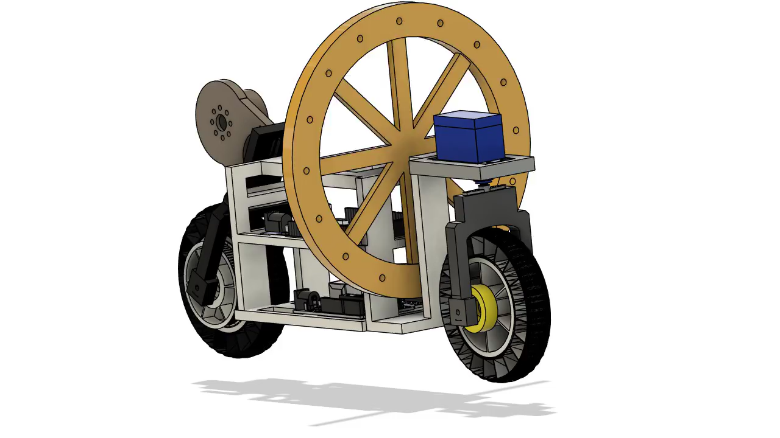
Self-Balancing and Traction Vehicle
Presented by:
Mukul- 220003055
Aravind- 220003050
Neelesh- 220003057
Gokul- 220003034
Hima- 220003024
Bhanu- 210003032

Slide 2
Problem Statement
Stability Issues
Small vehicles often fall on uneven ground or when pushed.
Movement Challenge
Difficult to balance while moving forward or backward.
Real-World Impact
Safety and performance concerns in transport and delivery robots.
Goal
Build a self-balancing vehicle with stable forward and backward motion.

Slide 3
Our Solution
Sensor Input
Motor Control
MPU6050 measures tilt angle continuously.
Motors adjust wheel rotation to correct balance.
Arduino calculates lean angle for control.
3D CAD design guided prototype construction.

Slide 4
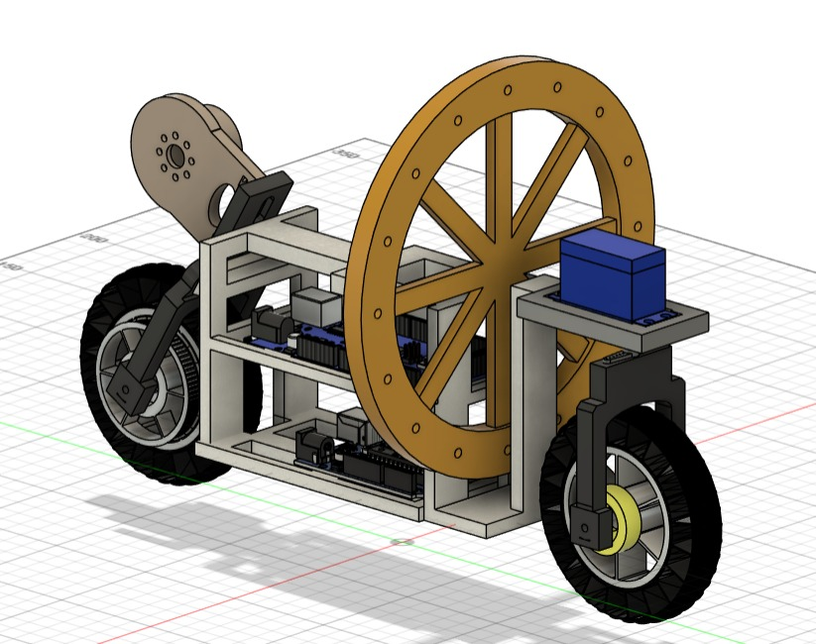
CAD Design Overview
Top Layer
Battery placement for balanced weight distribution.
Middle Layer
Arduino and motor driver board secured here.
Bottom Layer
Wiring and switches organized for safety.

Slide 5
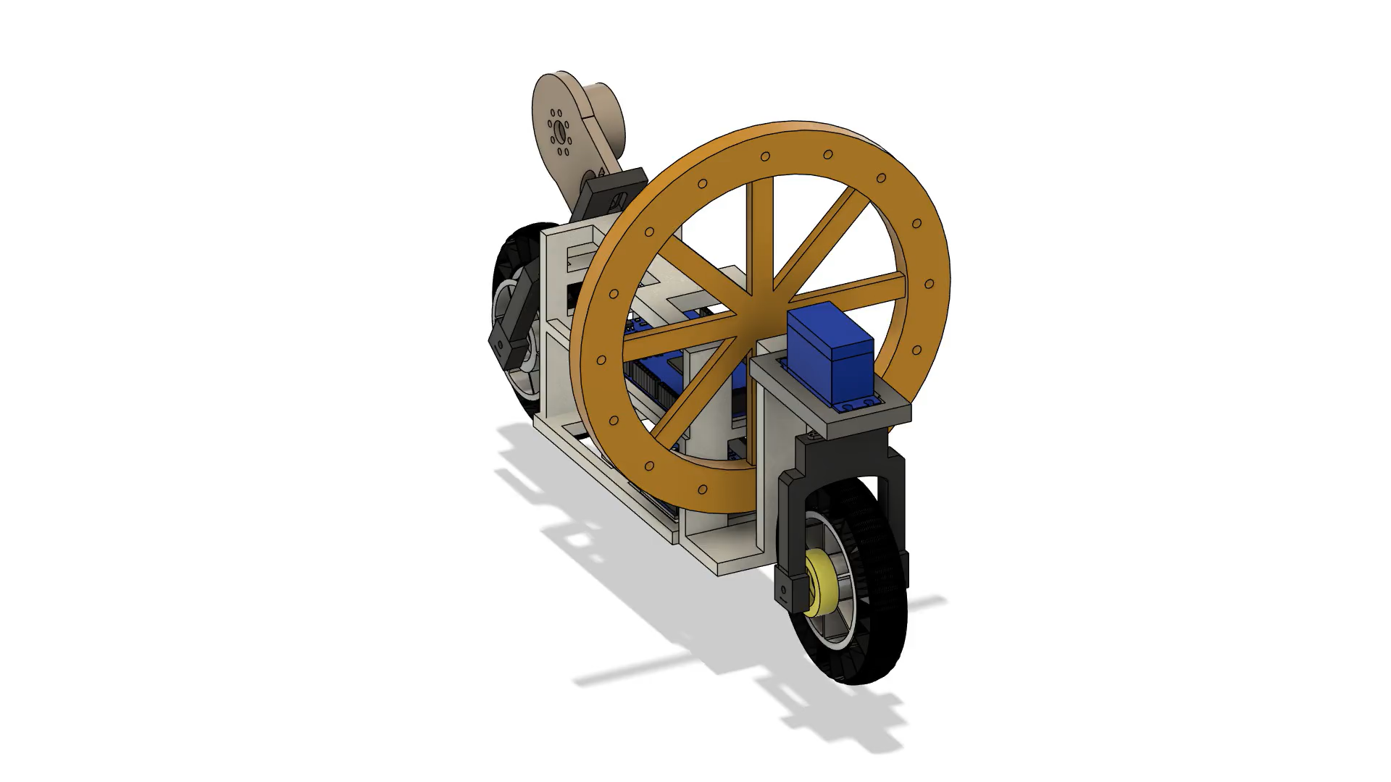

Slide 6
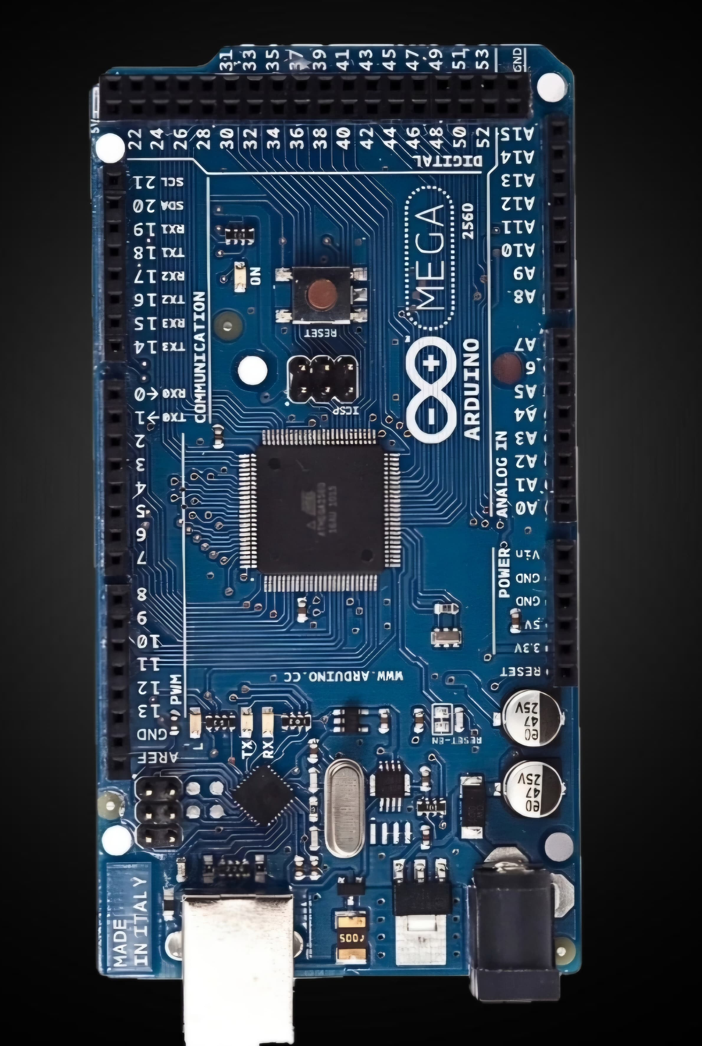



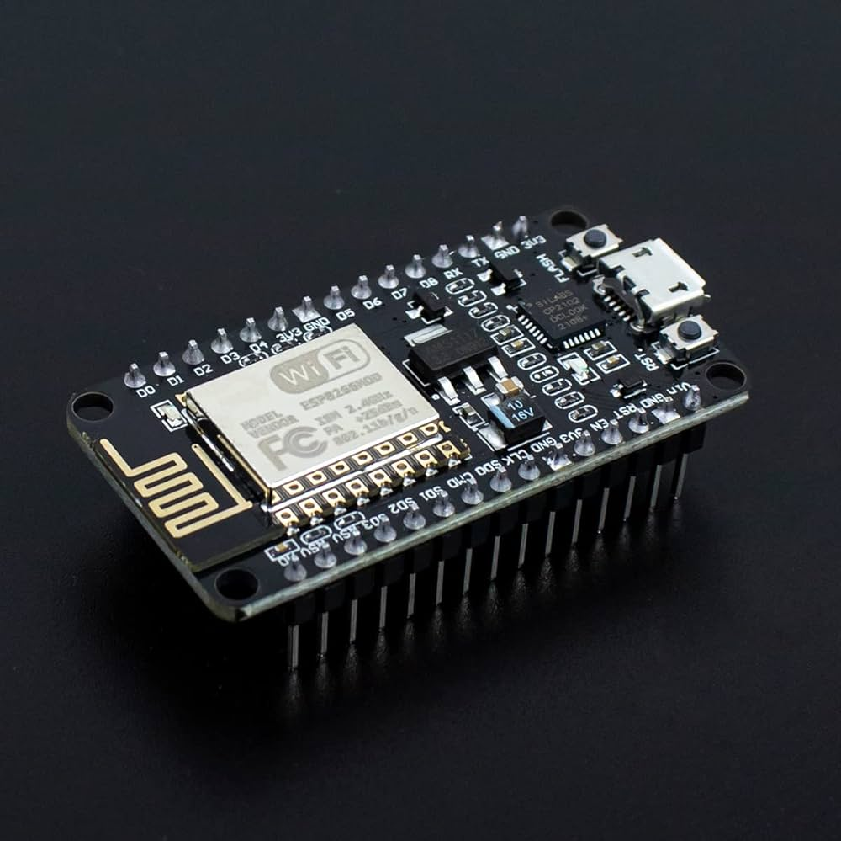

Main Components
Arduino
MPU6050 Sensor
L298D Driver
Processes sensor data and controls motors.
Controls motor direction and speed.
Measures tilt angle and angular velocity.
ESP8266
Wi-Fi control and communication
DC Geared Motors
Drive wheels and maintain balance.

Slide 7
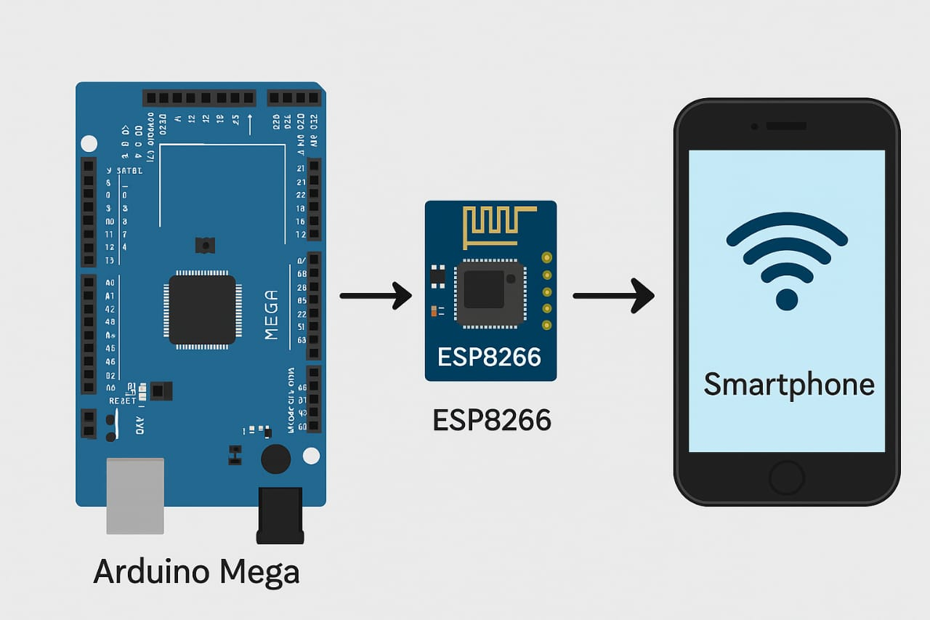



Supporting Components
Battery
Frame
Supplies power to motors and electronics.
Durable structure holding all components together.
Jumper Wires & Switch
Connect components and allow power control.

Slide 8
Working Principle
🔹 1. Tilt Sensing using MPU6050
Detects real-time tilt angle using gyroscope and accelerometer data.
🔹 2. PID Control Algorithm
Calculates corrective output based on error between desired and actual tilt.
Balances the bike by adjusting motor torque proportionally, integrally, and differentially.
🔹 3. Flywheel-Based Stabilization
High-speed rotating flywheel creates gyroscopic torque to counteract bike tilting.
Controlled by a DC motor via L298N motor driver.
🔹 4. Steering and Rear Wheel Control
MG995 servo motor used for steering based on user input.
Rear wheel powered by Mitsumi DC motor through L293D driver.
🔹 5. Wireless Mobile Control
ESP8266 hosts a web-based UI for remote commands like forward, reverse, steer, and stop.
Speed and direction are updated wirelessly in real-time.

Slide 9
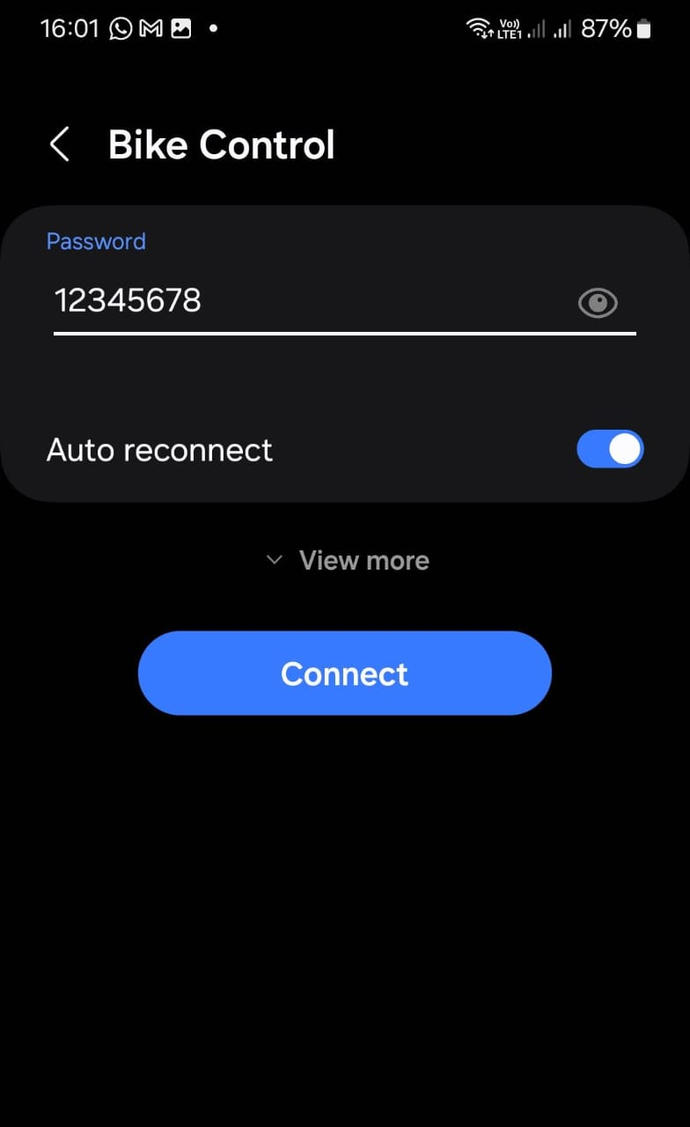
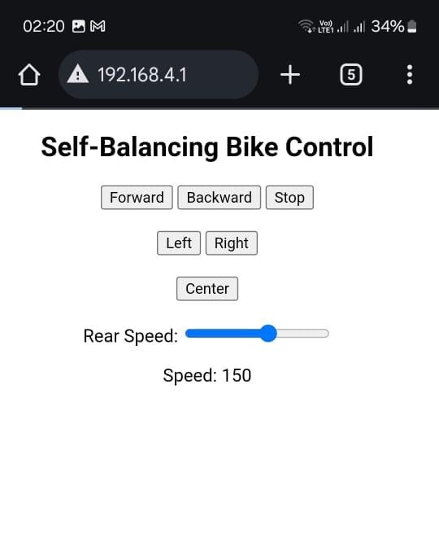
What We Learned
How to use microcontrollers and sensors in a real system.
Sensor Accuracy: MPU6050 provides real-time tilt data for precise control.
Control System: Arduino and motor drivers coordinate to maintain equilibrium.
Prototype Validation: Model closely matches CAD design with thoughtful wiring.
How to set up wifi hotspot using ESP8266
Prepare a HTML Page to control the vehicle.

Slide 10
Advantages
Transportation
Better stability in traffic and narrow lanes
Ideal for urban commuting and last-mile delivery
Robotics & Automation
Enables autonomous delivery robots with balance.
Useful in tight indoor environments (e.g., hospitals, warehouses)
Improved Stability and Safety: Helps prevent tipping over, useful in uneven terrain or during sudden movements.
Ease of Use: Simplifies operation for users with less driving or riding experience.
Increased Safety: Prevents wheel slip during acceleration on slippery surfaces like rain, ice, or gravel.
Improved Vehicle Performance: Ensures optimal power distribution to the wheels for efficient acceleration. Enhanced Towing and Load-Carrying: Traction control helps prevent traction loss due to shifting weight.

Slide 11
THANK YOU

